Slide 1
Minimal Spanning Trees
and our first named algorithm

Slide 2


Slide 3

What is a minimal spanning tree?
A spanning tree is a subset of Graph G, which has all the vertices covered with the minimum sum of weights on the edges.
Hence, a spanning tree does not have cycles and it cannot be disconnected.

Slide 4
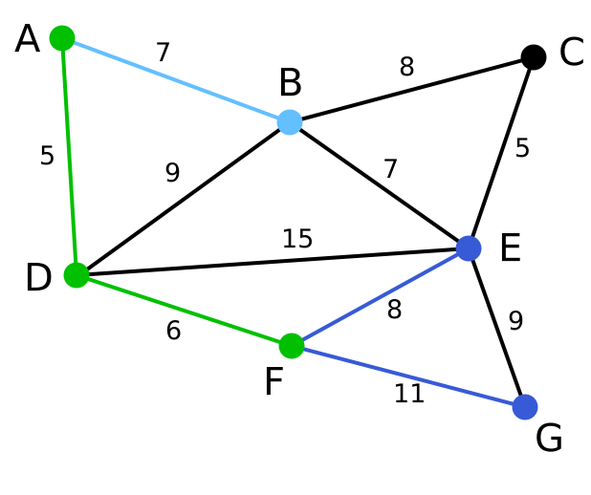

Find the minimal spanning tree for the following graph

Slide 5
Find the minimal spanning tree for the following graph

Slide 6
Prim’s Algorithm
Step 1 - Initialize a tree with a single vertex, chosen arbitrarily from the graph.
Step 2 - Grow the tree by one edge: of the edges that connect the tree to vertices not yet in the tree, find the minimum-weight edge, and transfer it to the tree.
Step 3 - Repeat step 2 (until all vertices are in the tree).

Slide 7
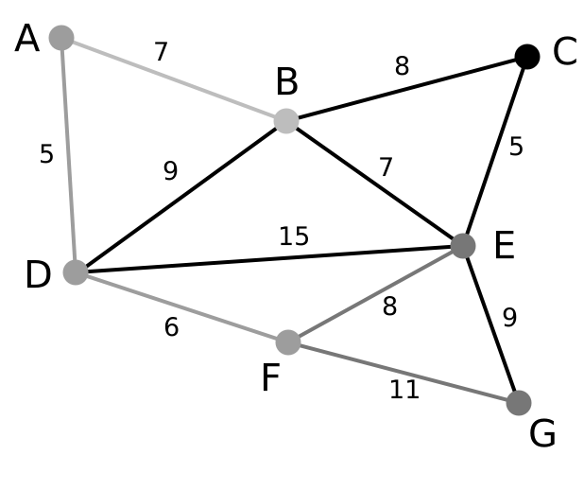

Slide 8
Prim’s Algorithm is Greedy
Prim’s Algorithm is a greedy algorithm. It always takes the most beneficial option that is immediately available, even if there were a better option to occur in the future.

Slide 9
Code up Prim’s Algorithm!
nodes = [[0,45,167], [1,208,179], [2,127,176], [3,164,252], [4,79,242], [5,117,318], [6,197,331]]
for n in nodes:
new_node = graph.add_node(id =n[0])
new_node.set_position(n[1], n[2], relative = False)
edges = [[0,2,7], [1,2,8], [3,1,5], [4,3,15], [3,2,7], [0,4,5], [2,4,9], [5,4,6], [5,3,8], [6,5,11], [6,3,9]]
for e in edges:
n1 = graph.node(e[0])
n2 = graph.node(e[1])
weight = e[2]
new_edge = graph.add_edge(n1, n2,weight)

